Slide 1




NSTP031
National Service Training Program 1

Slide 2

Preliminaries
Prayer
National Anthem
Panunumpa sa watawat ng Pilipinas
Panatang Makabayan
(CALABARZON March)
MMCL Vision
MMCL Mission
Malayan Hymn

Slide 3
Module 1.4
Drugs and Substance Abuse

Slide 4
"If you were hired today, what is the first thing you would want to know about your rights as an employee?"

Slide 5

Learning Objectives
At the end of the session, the students should be able to:
Explain the nature of drugs, drug menace, controlled substances as well as the national drug situation.
Explain the effects of substance abuse to the society.
Propose initiatives that the youth can take in the country’s fight against illegal drugs.

Slide 6
Pre-test
Before we begin, please access Blackboard Learn and complete the 10-item Pre-Test. This activity will help determine your prior knowledge of labor rights, responsibilities, and workplace protections.

Slide 7
“Why do you think labor education is taught before you enter the workforce?”

Slide 8
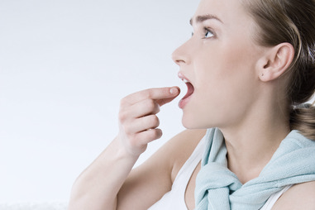

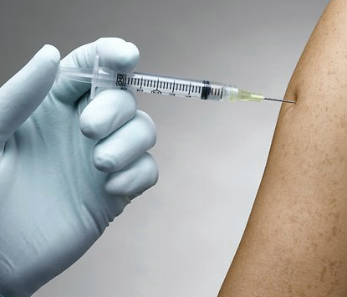
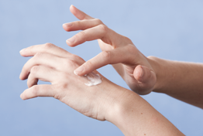
Nature of Drug and Drug Abuse
What is a Drug?
A chemical substance that brings about physical, emotional, or behavioral change.
How are Drugs taken?
Ingestion
Inhalation
Injection
Applied Topically

Slide 9
“Why do you think people turn to drugs?”

Slide 10

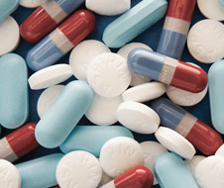

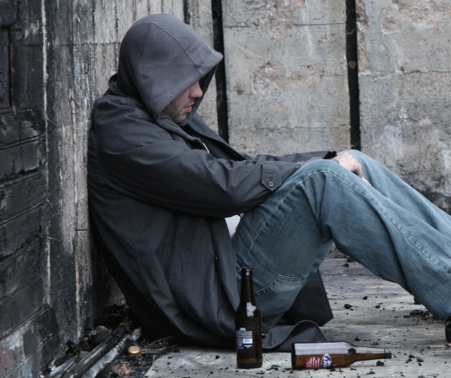
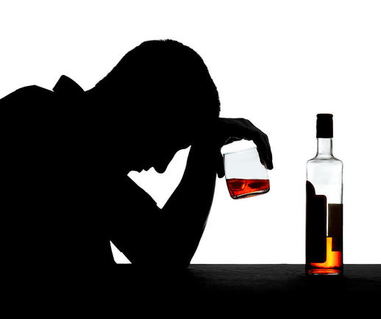
Nature of Drug and Drug Abuse
Why Do People Turn to Drugs?
As an attempt to solve problems
Widespread access to drugs
Peer Pressure
Under the impression that drugs give enjoyment
As an alcoholic substitute

Slide 11
Nature of Drug and Drug Abuse
When are Drugs Harmful?
When taken in excess.
When taken in dangerous combinations.
When taken by a hypersensitive person.

Slide 12
Nature of Drug and Drug Abuse
Forms of Drug Abuse?
Using, without benefit or prescription, useful drugs which have the capacity to alter mood or behavior.
Using drugs and substances for a purpose different from the one for which the drug has been prescribed.
Using drugs and substances having no legitimate medical application for purposes other than research.

Slide 13



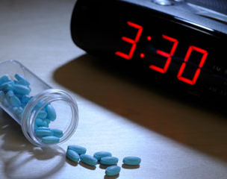
Nature of Drug and Drug Abuse
What are the Types of Drugs?
Stimulants
Hallucinogens
Sedatives
Narcotics

Slide 14
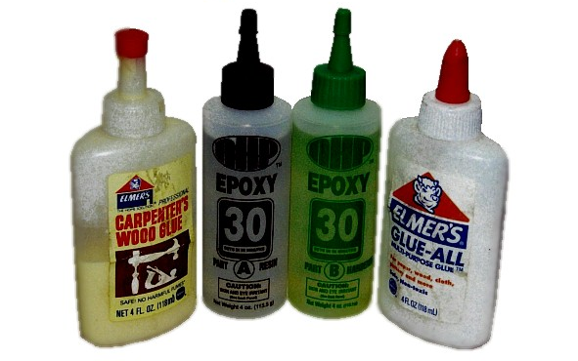
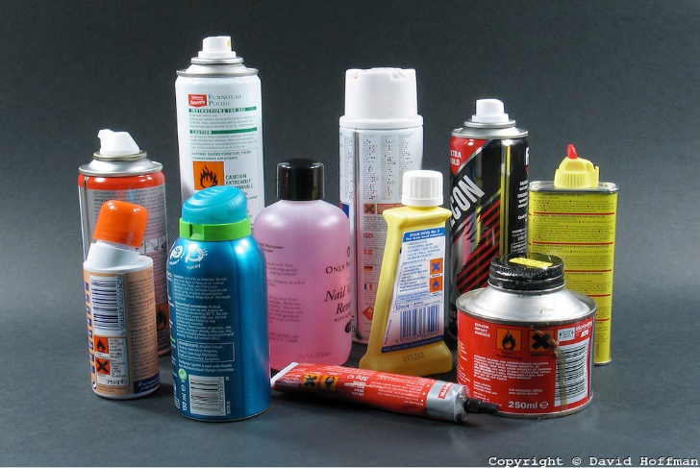
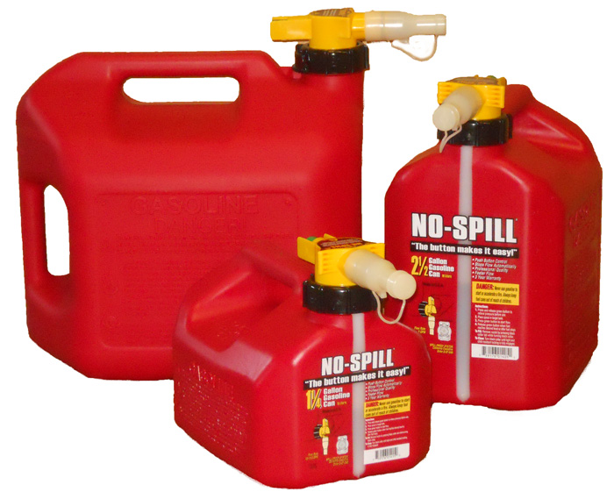
Nature of Drug and Drug Abuse
Other Products that are abused:
Glue
Paint Thinners
Gasoline

Slide 15
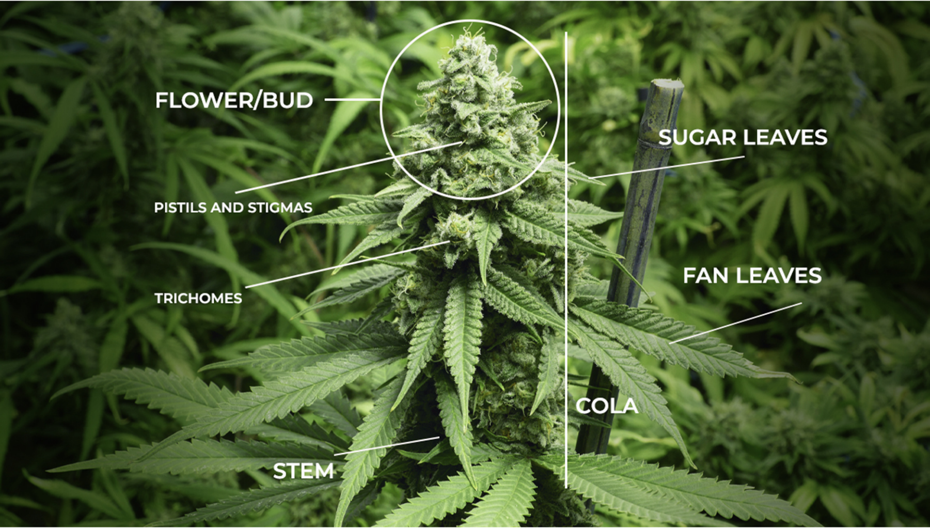
Common Drug Types
Marijuana
is the dried flowers of the cannabis plant, also known as weed or pot. It's typically smoked in joints, pipes, or blunts.
Adverse Effects
On the Brain & Mind:
It worsens memory, math, reading, and understanding.
Can cause anxiety, panic attacks, paranoia, and a loss of motivation.
It can also trigger or worsen symptoms of mental illness.
On the Body & Health:
It impairs motor skills, increasing the risk of accidents.
It can cause breathing problems like bronchitis and may lead to lung cancer.
It weakens the immune system, making you more prone to infections.
In males, it can reduce sperm production and lower testosterone levels.

Slide 16
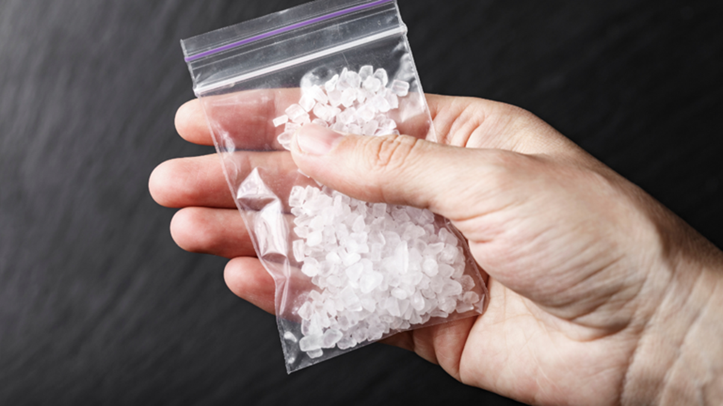
Common Drug Types
Crystal Methamphetamine
This is a highly addictive stimulant, also known as "shabu" or "ice."
It's a white, crystalline powder that severely damages the central nervous system.
Shabu is typically snorted, ingested, injected, or inhaled.
Adverse Effects
Short-Term Effects:
Increased attention and wakefulness
Decreased appetite
Intense feeling of happiness or excitement.
abnormal or rapid heartbeat
high body temperature (hyperthermia), and convulsions.
Long-Term Effects:
paranoia, hallucinations, and repetitive motor activity.
problems with thinking, motor skills, and memory loss.
aggressive or violent behavior and mood disturbances.
severe dental problems ("meth mouth")
extreme weight loss, and an increased susceptibility to various illnesses.

Slide 17
Common Drug Types
Inhalants
Inhalants are chemical substances found in common household products like glue, gasoline, and cleaning supplies.
People intentionally inhale their vapors to get high.
Adverse Effects
Short Term Effects:
confusion, distorted perception of time and distance, and hallucinations.
nausea, vomiting, drowsiness, and weight loss.
Users may become aggressive or violent.
Long Term Effects:
permanent damage to the brain, central nervous system, kidneys, liver, and bone marrow.
memory loss, an inability to think clearly, muscle cramps, weakness, and numbness in the limbs.
chronic abdominal pains.
can lead to accidents, drowning, falls, and even "sudden sniffing death syndrome."

Slide 18
Other Substances
Opiates or Narcotics - Used for pain relief
Opium - a depressant drug
Cocaine - a fast-acting stimulant
Tobacco and Nicotine - highly addictive stimulant as well
Steroids - contains male hormones for muscle mass building
Sedatives - includes tranquilizers and sleeping pills

Slide 19
Common Signs of Drug Abuse

Slide 20
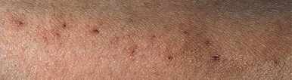
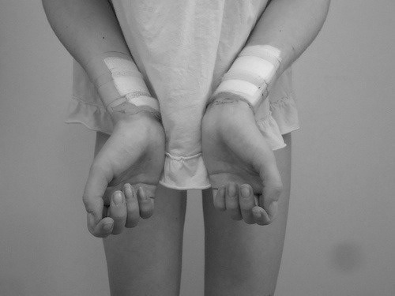
Common Signs of Drug Abuse
Injection marks of an addict
Unusual effort made to cover arms and hide needle marks

Slide 21
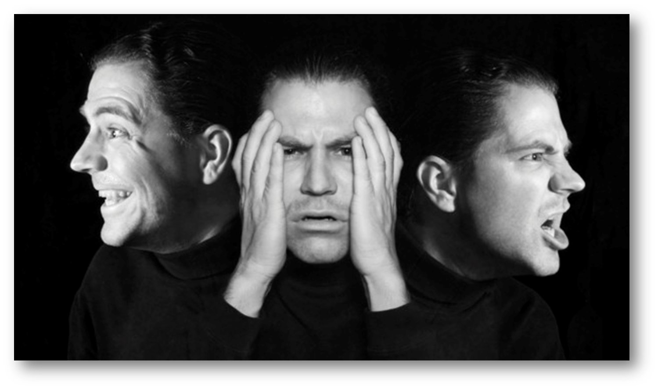
Common Signs of Drug Abuse
Sudden mood swings or angry outbursts.
Lethargy and loss of motivation.

Slide 22

Common Signs of Drug Abuse
Staying out late, not coming home, or frequent absences from work/school.
Reduced participation in extracurricular activities and social withdrawal.

Slide 23
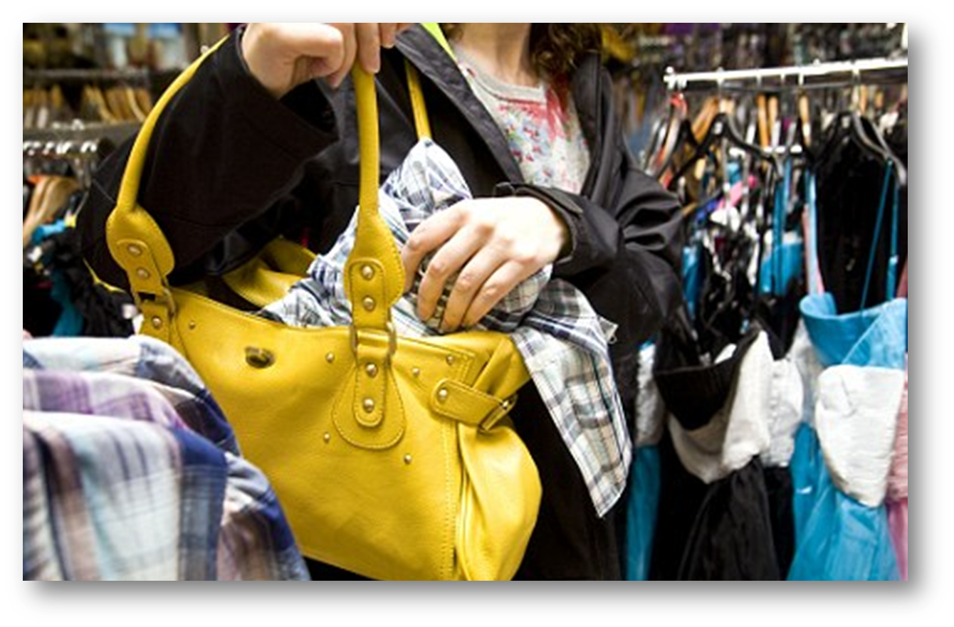
Common Signs of Drug Abuse
Unexplained need for money, or sudden loss of money and valuables.

Slide 24


Common Signs of Drug Abuse
Impaired memory and difficulty concentrating.
Changes in sleeping or eating patterns, often leading to tiredness.

Slide 25
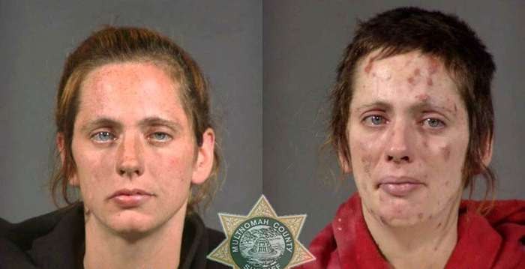
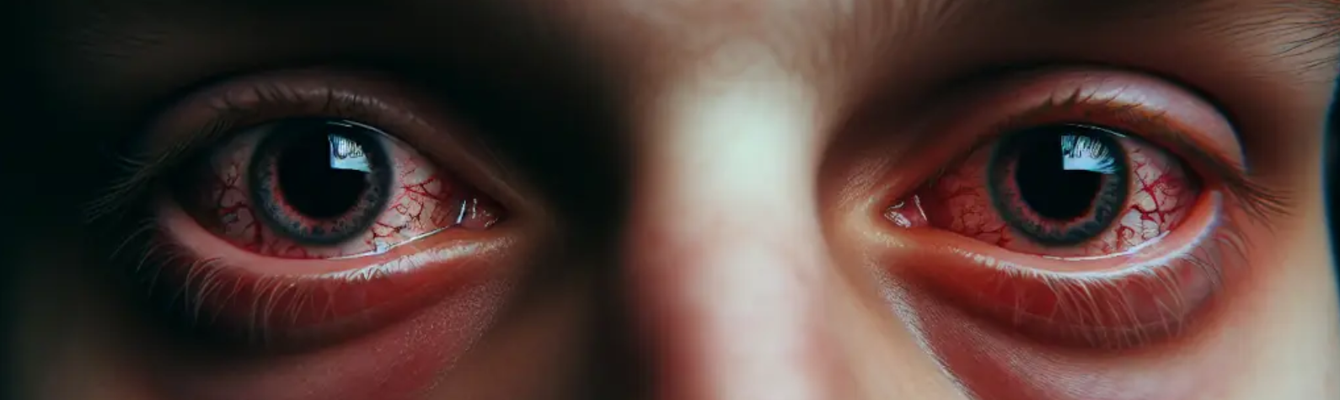
Common Signs of Drug Abuse
Bloodshot or glassy eyes.
Poor physical appearance (including inattention to personal hygiene)

Slide 26
Common Signs of Drug Abuse
Unexplained need for money, or sudden loss of money and valuables.

Slide 27
National Drug Situation

Slide 28

Drug Rehabilitation Statistics
2023 Statistics

Slide 29
Drug Rehabilitation Statistics
91.74% male
7.70% female
0.56% LGBT
youngest admission is 12 years old
most senior is 68
most of the admissions 40 and above

Slide 30
Drug Rehabilitation Statistics
(52.07%) are single
(23.26%) are married
(19.87%) have live-in partners
(4.80%) are either widow/er, separated, divorced, or annulled.

Slide 31
Drug Rehabilitation Statistics
(26.96%) have attained high school
(19.49%) have reached college
(17.53%) have graduated high school

Slide 32
Drug Rehabilitation Statistics
(57.90%) employed
(37.88%) unemployed
(3.46%) students
(0.58%) out-of-school youth
(0.18%) were pensioners
monthly family income is approximately thirteen thousand pesos (PHP 13,201.05)

Slide 33

QUESTIONS​

Slide 34
Individual Task: Myth or Fact
Objective : Evaluate common beliefs about drugs and substance abuse using credible sources and present
evidence-based conclusions.
Instructions :
The class will be divided into four groups.
Each group will be assigned 1 statement
They should:
  Determine whether the statement is a Myth or Fact.
  Research using reliable sources (DOH, WHO, UNODC, DDB, NIDA, CDC, etc.).
  Explain their answer.
  Present supporting evidence.
  Give at least one recommendation for prevention or awareness.

Slide 35
Individual Task: Myth or Fact
Group 1:
Marijuana is harmless because it is natural..
Questions:
Does natural always mean safe?
What are the possible health risks?
Can marijuana affect learning and decision-making?
Group 2:
Only poor people become involved in drug abuse..
Questions:
Can substance abuse affect people from different social classes?
What factors increase the risk of drug abuse?
What does research say?

Slide 36
Individual Task: Myth or Fact
Choose from the following Statements :
Group 3:
Prescription medicines cannot be abused because they come from doctors.
Questions:
What is prescription drug misuse?
Can taking medicines without a prescription be dangerous?
What are some common examples?
Group 4:
Peer pressure is one of the major reasons young people try drugs.
Questions:
How does peer influence affect decision-making?
What are examples of positive and negative peer pressure?
How can students resist harmful pressure?

Slide 37
Individual Task: Myth or Fact
Rubrics
Criteria | Points
Content Accuracy – Information | 5
Explanation & Analysis | 5
Application & Evidence | 5
Time Management & Submission | 5
Total | 20
DEADLINE: SEPTEMBER 7, 2026 (MONDAY) 11:59pm​
​

Slide 38
Synthesis

Slide 39
Post-test
Once again, please access Blackboard Learn and complete the 10-item Post-Test. This activity will evaluate your understanding of workers' rights and responsibilities, workplace protections, and appropriate mechanisms for addressing labor concerns.

Slide 40



Excellence and Virtue in
Community Service

